Slide 1

PROGRESS MEETING NO xxx
1st July 2017
Consultant Logo in every slide
Client Logo in every slide
Project :
Project photo here
Employer:
Engineer:
Main Contractor:
Contractor Logo in every slide

Slide 2
Contents
Presentation Content
Project Information
Overall Progress Status
Structure Status
Finishes Status

Slide 3
2. Project Information
Project Name | :
Client | :
Engineer | :
Scope of Work | :
Contract Value | : USD 3,580,000,000
Approved Variation | :
Adjusted Contract Value | :
Project Duration | : 48 months
Time Elapsed | : days
Remaining Duration | : Days
Commencement Date | : 17th Jan 2017
Completion Date | : xxx
Gross Work done Value up to June 2018

Slide 4
3. Programme & Progress
OVERALL PROGRESS STATUS

Slide 5
1.Project Information (Update)
Total Duration | Time Elapsed | Remaining Time
2057 Days | 833 days | 637 days
100 % | 59.38 % | 40.62 %
Progress based on Mhrs as of 30th June 2017 | Planned | Actual | Variance
 | 58.43% | 44.65% | -13.78%
 |  |  | Project delayed by -109 days
Financial Progress as of 30th June 17 | Planned till June 2017 (Proposed) | Actual Achieved till May 2017
 | 56.53% (829 m) | 52.29% (631 m)
Notes:
Do not add or delete the information on the slide. All information has to be available and must be filled. Do not change the description of the required information (i.e. Forecast completion date or so).
Provide only official contractual information about start, finish dates, contract values, certified progress value etc.
Work Executed (Value): Based on Earned Value. If your programme is cost (value) loaded, when you update the programme it will give you earned cumulative value. If your programme is not loaded with value, latest gross cumulative progress payment application/total contract value shall be entered.

Slide 6

I hope you will find these templates valuable. For more tips, visit
www.smartpmtraining.com
All the best!
Osama Saad

Slide 7
Progress % based on Mhrs – Rev 5.3
 | Cumulative last Week | Cumulative this Week | Progress Last Week | Progress this Week
Early Planned% | 57.16% | 58.43% | 1.24% | 1.27%
Late Planned % | 42.52% | 43.71% | 1.21% | 1.19%
Actual % | 43.67% | 44.65% | 0.98% | 0.98%
Variance | -13.49% | -13.78% | -0.26% | -0.29%
Progress Curve Here

Slide 8
Longest Path
The Overall Project completion date is delayed by 50 days up to 25 Dec 23.
Item | Description | Delay/Ahead Last Week | Delay/Ahead This Week | Remark
Longest Path | Façade Works | -110 days | -109 days | Delays reduced by 1 day.
Critical Path 2 | Doors Works | -95 days | -102 days | Delays increased by 7 days.
Critical Path 3 | False Ceiling Works | -66 days | -69 days | Catchup plan are in place and to catch up delays.
Critical Path 4 | MEP Work | -60 days | -65 days | Catchup plan are in place and to catch up delays.

Slide 9
Variance breakdown and Trend
Delay Variance
-13.78%
- 13.49%
Structure works
-1.66%
-1.64%
Drywall & Plaster
-1.63%
-1.59%
Tiling Works
-1.46%
-1.48%
Waterproofing
-0.16%
-0.16%
Ceiling Works
-2.93%
-2.83%
Balcony Handrail
-0.31%
-0.31%
MEP Works
-1.04%
-1.01%
Façade Works
-1.24%
-1.20%
This Week
Last Week

Slide 10
Monthly Progress % based on Mhrs
Month | Planned Early % | Planned Late % | Actual %
Dec 2016 | 5.31% | 3.20% | 3.22%
Jan 2017 | 5.28% | 3.24% | 3.77%
Feb 2017 | 4.92% | 3.29% | 3.72%
Mar 2017 | 5.01% | 4.30% | 3.73% (Less than late planned %)
Apr 2017 | 4.78% | 4.41% | 3.17% (Less than late planned %)
May 2017 | 4.72% | 4.23% | 3.16% (Less than late planned %)
June 2017 | 5.53% | 5.11% | 3.94% (Less than late planned %)
Project progress fall behind monthly late finish from Mar 2020 due to Covid-19, Sudden Payment deduction and delay in payment.

Slide 11
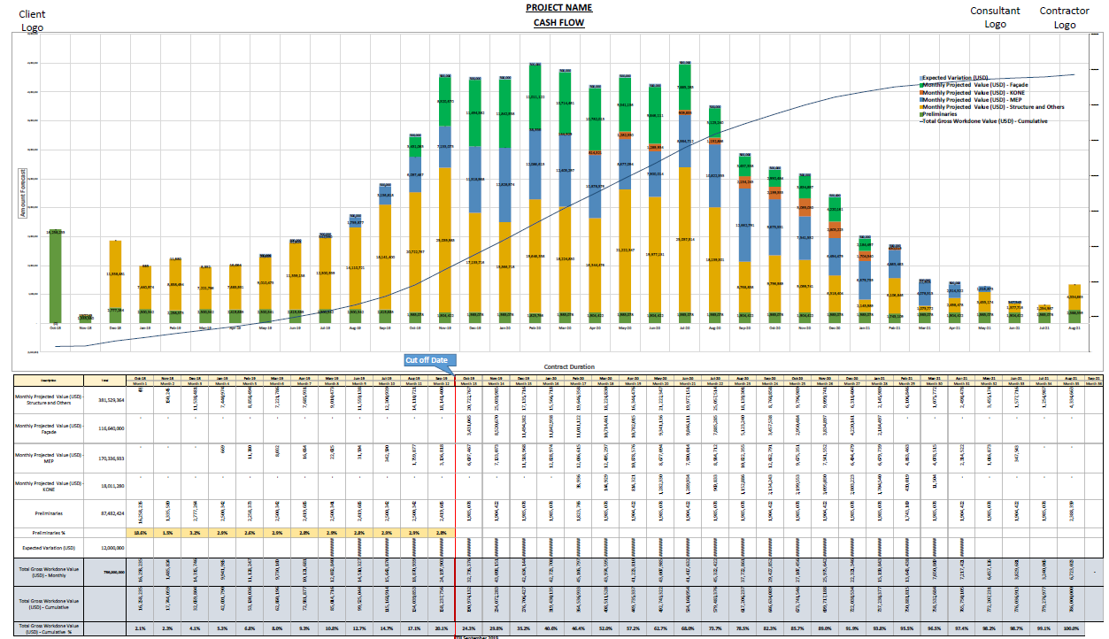
Cash Flow

Slide 12
Manpower Histogram
Mitigation Manpower reduced due to Covid-19 and Payment issues

Slide 13
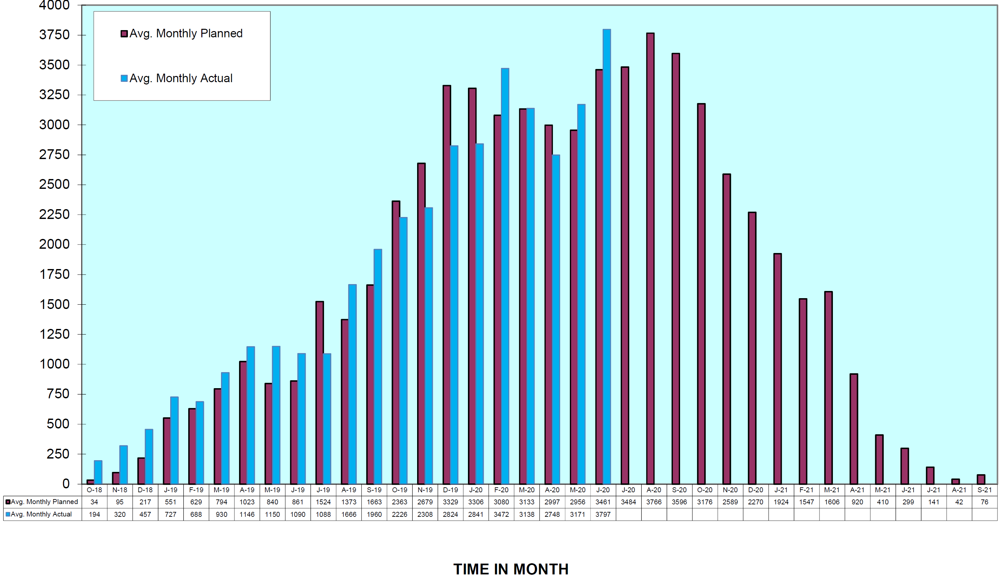
Manpower Histogram
Manpower Status

Slide 14
4. Payment Status
5. Finance
Total Deduction : 51 Million
1. Preliminaries : 36 Million
2. Variation (on account) : 31 Million
3. ACS System : 7.5 Million
4. Facade : 15 Million
5. MEP : 29 Million
(Include 10% Advance Payment recovery, Deduction of 5% Retention and not considered 5% Vat)

Slide 15
3. Programme & Progress
DETAILED CONSTRUCTION PROGRESS

Slide 16
Structure Works

Slide 17
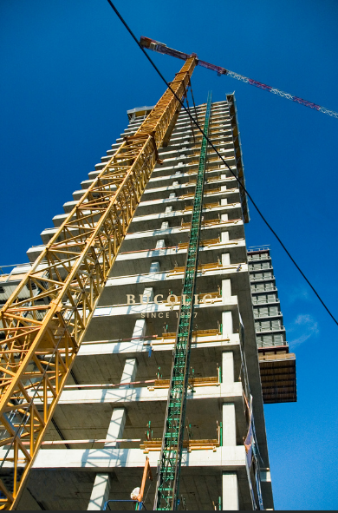
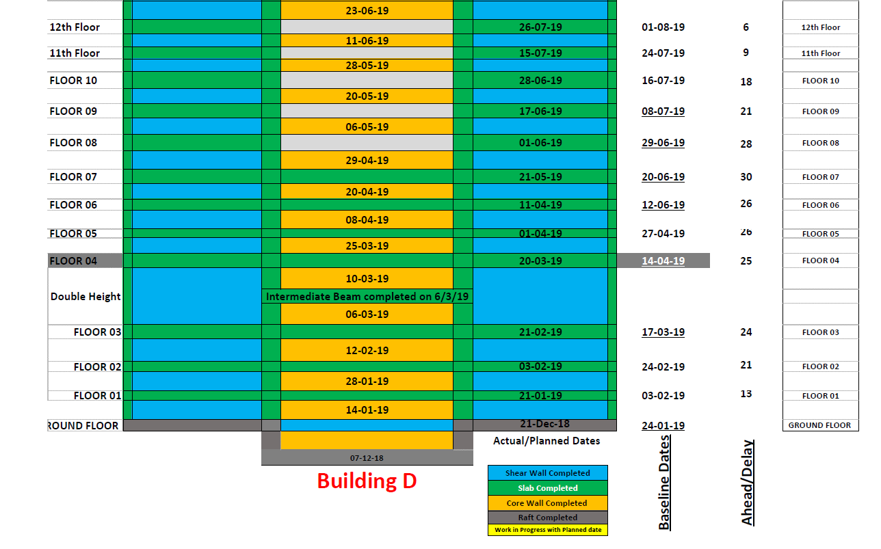
Structure Progress
Baseline Structure completion date : 15 May 2023
Forecasted Structure completion date: 10 Oct 2021 (-31 days)

Slide 18
Finishing Works

Slide 19
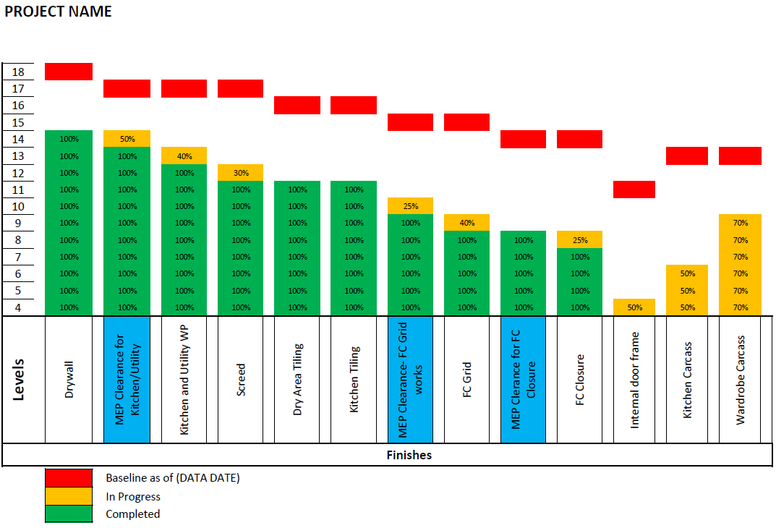
Tower 1 – Finishing & MEP Works

Slide 20
Facade Works

Slide 21
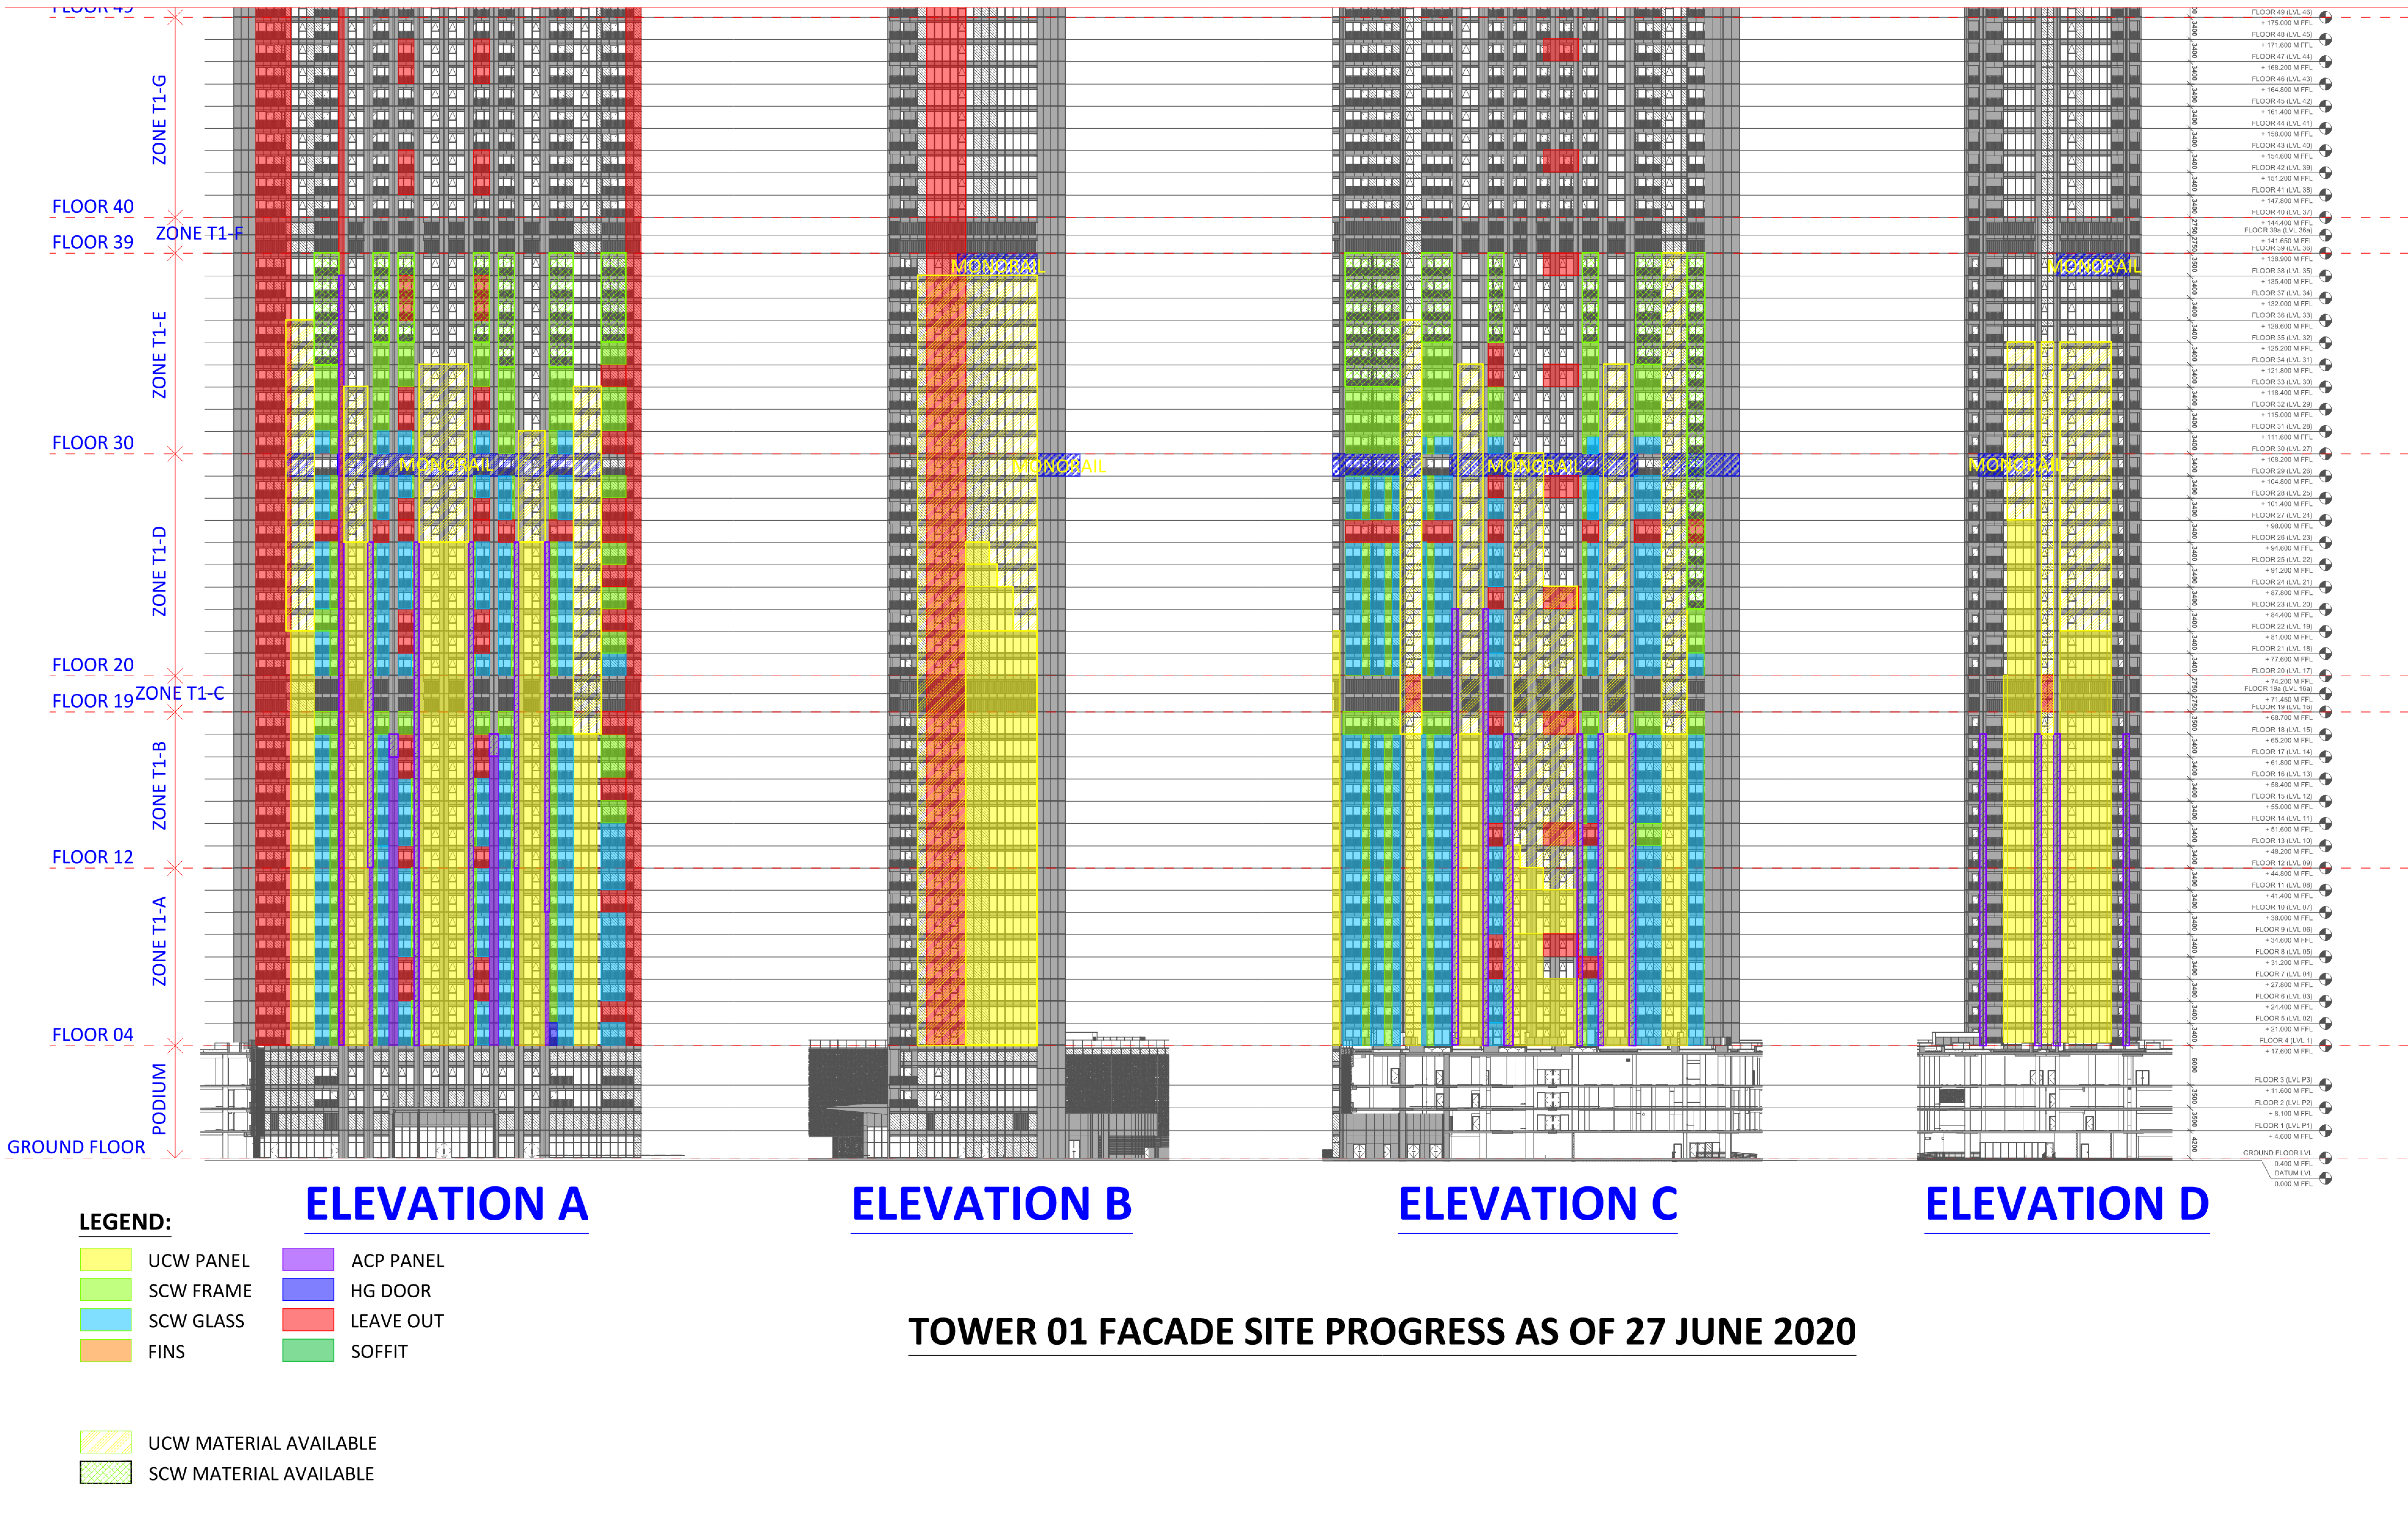
Façade Works – Tower 1
Façade Progress
Update as of 30 JUN 17
Building D

